Slide 1
MAX Plus Algebra
Waylon Jepsen

Slide 2
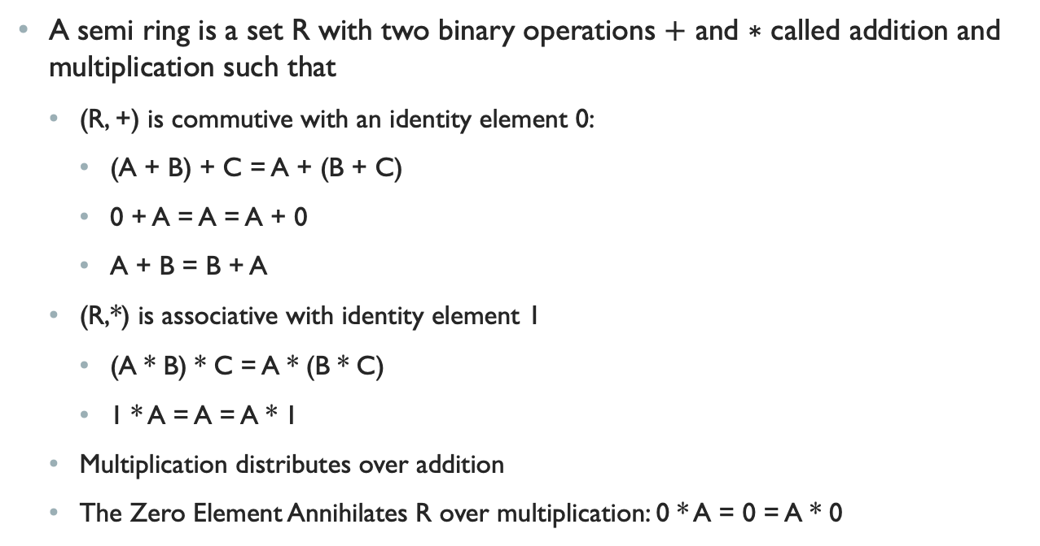
Max Plus Algebra is a Semi-ring
A semi ring is a set R with two binary operations $+$ and $∗$ called addition and multiplication such that
(R, +) is commutive with an identity element 0:
(A + B) + C = A + (B + C)
0 + A = A = A + 0
A + B = B + A
(R,*) is associative with identity element 1
(A * B) * C = A * (B * C)
1 * A = A = A * 1
Multiplication distributes over addition
The Zero Element Annihilates R over multiplication: 0 * A = 0 = A * 0

Slide 3
Ring vs Semi-Ring
A Semi ring omits the requirement of an additive inverse
In a ring an additive inverse implies a multiplicative zero which is why it needs to be explicitly specified here.
(Max, +) and (Min, +) are classified as tropical semi-rings (where Min/Max and addition is used to replace the traditional multiplication and addition.
These tropical semi-rings have applications in evaluating the performance of discrete event systems.
Real numbers are arrival times
Max can be used to refer to waiting for a completion of all prior events
Min can be used to select the best least costly choice
+ is an accumulation along a path

Slide 4
Examples in Computer Science
The Floyd-Warshall Algorithm is an algorithm for finding shortest paths in a directed weighted graph.
Described by the (min, +) tropical semi-ring.
+ accumulates the weight along a path
min chooses the shortest one.
The Viterbi algorithm for dynamic programing applies a similar representation

Slide 5
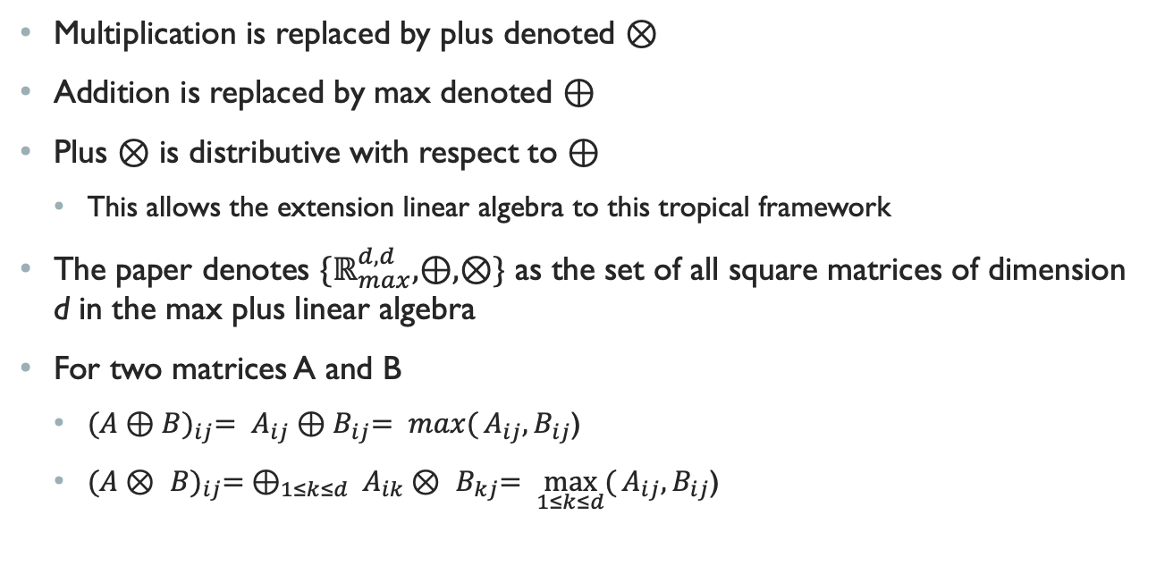
Max plus
Multiplication is replaced by plus denoted $⊗$
Addition is replaced by max denoted $⊕$
Plus $⊗$ is distributive with respect to $⊕$
This allows the extension linear algebra to this tropical framework
The paper denotes ${\{ℝ}_{max}^{d,d},⊕,⊗\}$ as the set of all square matrices of dimension d in the max plus linear algebra
For two matrices A and B
${(A⊕B)}_{ij}= A_{ij}{⊕B}_{ij}= \max{(}A_{ij}{,B}_{ij}$)
${(A⊗ B)}_{ij}= ⊕_{1≤k≤d} A_{ik}{⊗ B}_{kj}= \max_{1≤k≤d}{(}A_{ij}{,B}_{ij}$)

Slide 6
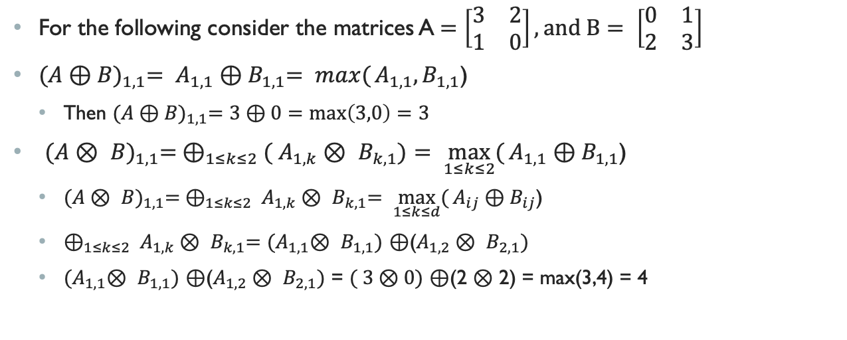
Examples
For the following consider the matrices A$=\left[\begin{matrix}3 & 2 \\ 1 & 0\end{matrix}\right], and B= \left[\begin{matrix}0 & 1 \\ 2 & 3\end{matrix}\right]$
${(A⊕B)}_{1,1}= A_{1,1}{⊕B}_{1,1}= \max{(}A_{1,1}{,B}_{1,1}$)
Then ${(A⊕B)}_{1,1}=3⊕0=max\left(3,0\right)=3$
${(A⊗ B)}_{1,1}= ⊕_{1≤k≤2}( A_{1,k}{⊗ B}_{k,1})= \max_{1≤k≤2}{(}A_{1,1}{⊕B}_{1,1}$)
${(A⊗ B)}_{1,1}= ⊕_{1≤k≤2} A_{1,k}{⊗ B}_{k,1}= \max_{1≤k≤d}{(}A_{ij}{⊕B}_{ij}$)
$⊕_{1≤k≤2} A_{1,k}{⊗ B}_{k,1}=$ ${(A}_{1,1}{⊗ B}_{1,1})$ $⊕$($A_{1,2}{⊗ B}_{2,1})$
${(A}_{1,1}{⊗ B}_{1,1})$ $⊕$($A_{1,2}{⊗ B}_{2,1})$ = $( 3⊗0)$ $⊕$(2 $⊗$ 2) = max(3,4) = 4

